Slide 1

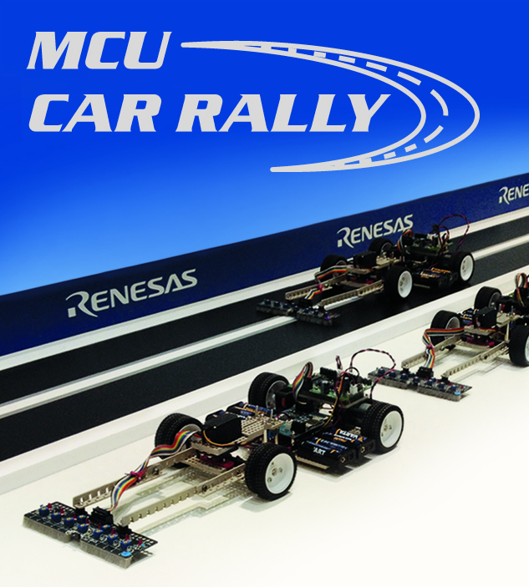
Renesas MCU Car Rally 2018
Faculty of Computing, Engineering and Science
University of South Wales – 2017/18
MEng Group Project
Weekly Report
Students:
13013521 Thomas Brown – MEng Electrical and Electronic Engineering
15021106 Kayin Templar– MEng Electrical and Electronic Engineering
14031329 Miguel Santos – MEng Computer Systems Engineering
Lecturer:
Prof Gouping Liu

Slide 2
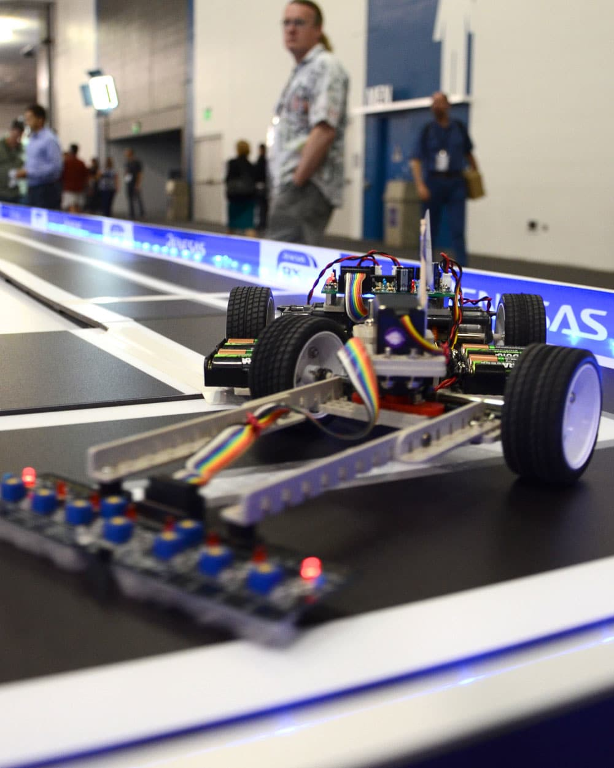
Weeks 4 and 5 – 11 and 18 October 2017
Recap of week 4
Revising the feature proposals
This week’s developments
Next week…
MEng Group Project – Renesas MCU Car Rally 2017/18

Slide 3
Recap of week 4
Last week was mostly dedicated to planning (theory) and setting up the required tools for development.
These plans included:
Using a treadmill to drive the car in order to discover the best battery for this application
Figuring out a method to get feedback from the Servo motor
In addition to this, e2studio and FDT (Flash Development Toolkit) were setup.
MEng Group Project – Renesas MCU Car Rally 2017/18

Slide 4
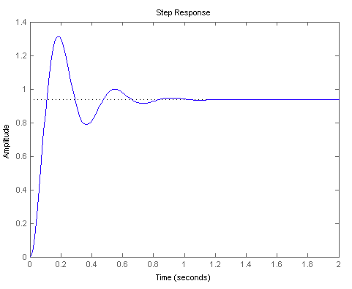
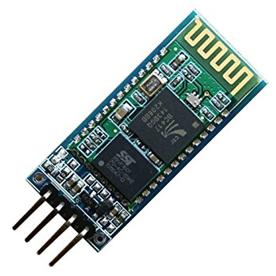
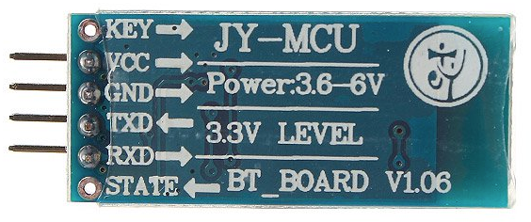
Revising the feature proposals
At this point in time, these are the features that have been proposed:
Mechanical:
Make the car shorter and wider to increase stability
Distribute weight at the back of the car for momentum and stability
Use a different set of wheels
Electrical:
Speed controller for DC motor
3-Axis accelerometer (secondary to the speed controller)
Bluetooth module with the component HC-06 (uses standard UART communication)
Software:
Efficient PID controller for the servo and the two DC motors - Updated
Smart line tracker system
Track mapping using speed controller and 3-axis accelerometer
RTOS - (Micrium)
Real time wireless communication
Windows and Android application to control and debug the car’s parameters in real time
MEng Group Project – Renesas MCU Car Rally 2017/18

Slide 5
This week’s developments
This week, we worked on:
The servo control and its parameters
The transfer functions for the PID controller
Real Time Operating System (RTOS Micrium) is now functional
Wireless communication with the RX62G
MEng Group Project – Renesas MCU Car Rally 2017/18

Slide 6
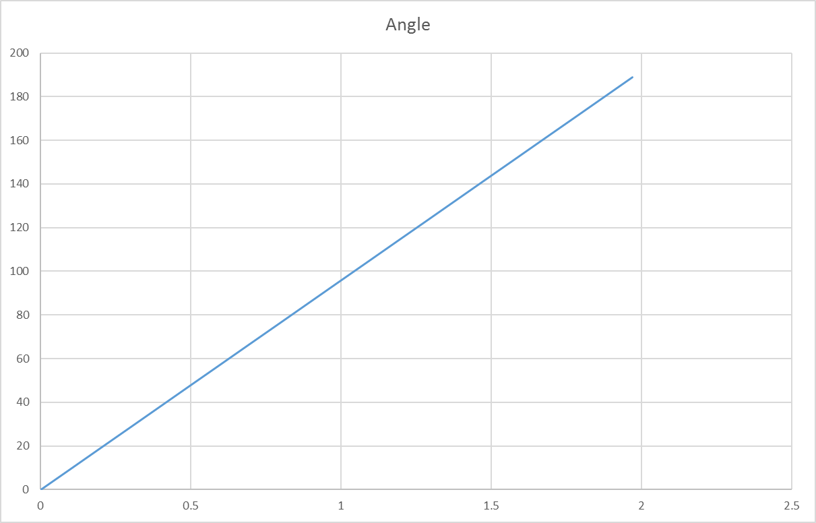
This week’s developments - detailed
Servo control
Servo Transfer Function
Both theoretical and physical results showed a proportional response
The data sheet shows a response speed of 0.096μs (no load)
This response gives the graph seen right
A physical test showed the same linear response with a minor load
This should be retested at full load but should still be linear
Servo Feedback
The servo uses an internal feedback potentiometer
This can be accessed by drilling a hole in the casing and running a wire back to the microcontroller
MEng Group Project – Renesas MCU Car Rally 2017/18

Slide 7
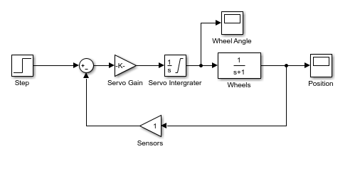
This week’s developments - detailed
PID Transfer functions
The Modelling of position control
Matlab is being used to create the most accurate model
The servo has both a gain (to convert PWM to an angle demand)
and an integrator
2. The position of the wheels will feature both integration
and a frequency dependent component
3. The response to a basic closed loop system of this is shown on next slide
This week
Use this closed loop model to derive the transfer function
between the servo and the position
2. Decide on appropriate feedback value
MEng Group Project – Renesas MCU Car Rally 2017/18

Slide 8
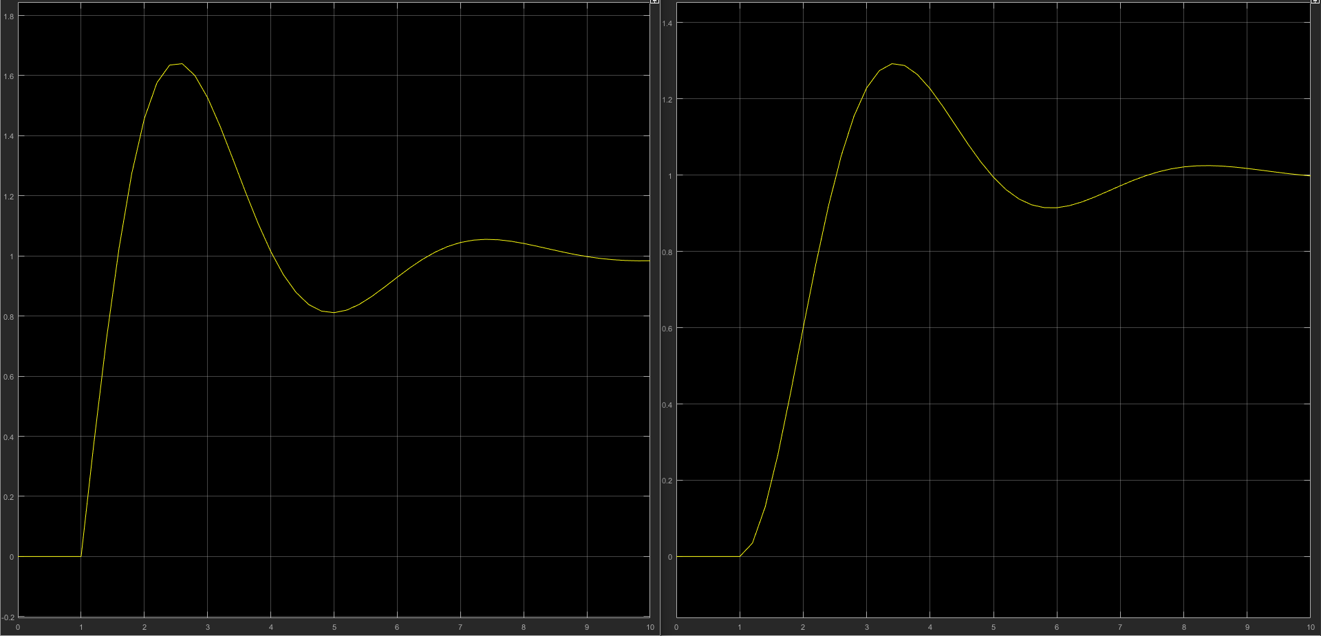
MEng Group Project – Renesas MCU Car Rally 2017/18

Slide 9
This week’s developments - detailed
Regarding RTOS…
The why:
We need to do multiple things at the same time, such as:
Control the car
Read the front sensors
Read the accelerometer
Fetch feedback data from the control system
Communicate with the user
Measure and learn the track
The how:
We’re using Micrium RTOS for the RX62N MCU (thankfully works with the RX62G)
Patched RTOS to execute code at a higher rate that is not explicitly allowed (faster than 1ms)
MEng Group Project – Renesas MCU Car Rally 2017/18

Slide 10
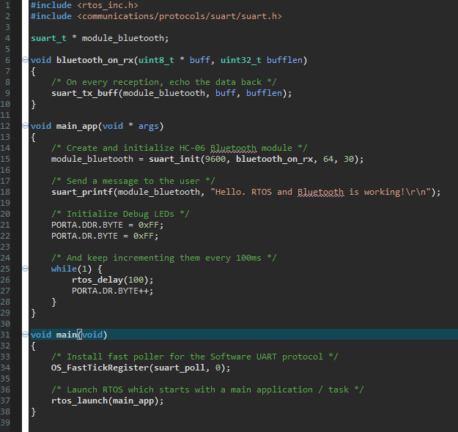
This week’s developments - detailed
And how to use it:
MEng Group Project – Renesas MCU Car Rally 2017/18

Slide 11
This week’s developments - detailed
Regarding the Wireless communication…
The module being used is the HC-06
Its main specs are:
3.6v up to 6v required on its power rail
Uses standard UART protocol via pins RXD and TXD
Its baud rate ranges from 9600 up to 115200 (we’re using 9600 at the moment)
Can connect to a computer with Bluetooth or any Android/iPhone
Will allow us to read debug messages on the computer/phone and change parameters while the program is live
MEng Group Project – Renesas MCU Car Rally 2017/18

Slide 12
Next week…
This coming week will be dedicated to:
Assembling and soldering the car
Discovering the best battery using the treadmill
Completing/improving the theory for the PID controller
Developing software for the control of the car
Developing a Windows application which will help communicate effectively with the car
MEng Group Project – Renesas MCU Car Rally 2017/18

Slide 13
Questions?

